Slide 1


Machine Learning with H₂O
Jo-fai (Joe) Chow
Data Scientist
joe@h2o.ai
@matlabulous
ODSC Masterclass Summit
1st March, 2017

Slide 2
About Me
Civil (Water) Engineer
2010 – 2015
Consultant (UK)
Utilities
Asset Management
Constrained Optimization
Industrial PhD (UK)
Infrastructure Design Optimization
Machine Learning + Water Engineering
Discovered H₂O in 2014
Data Scientist
2015
Virgin Media (UK)
Domino Data Lab (Silicon Valley)
2016 – Present
H₂O.ai (Silicon Valley)

Slide 3
Learning Objectives
Start and connect to a local H₂O cluster from R/Python.
Import data from R/Python data frames, local files or web.
Perform basic data transformation and exploration.
Train classification and regression models using H₂O machine learning algorithms.
Evaluate models and make predictions.
Improve performance by tuning and stacking.

Slide 4
H₂O Examples in R & Python bit.ly/odsc_h2o_ml_2017

Slide 5
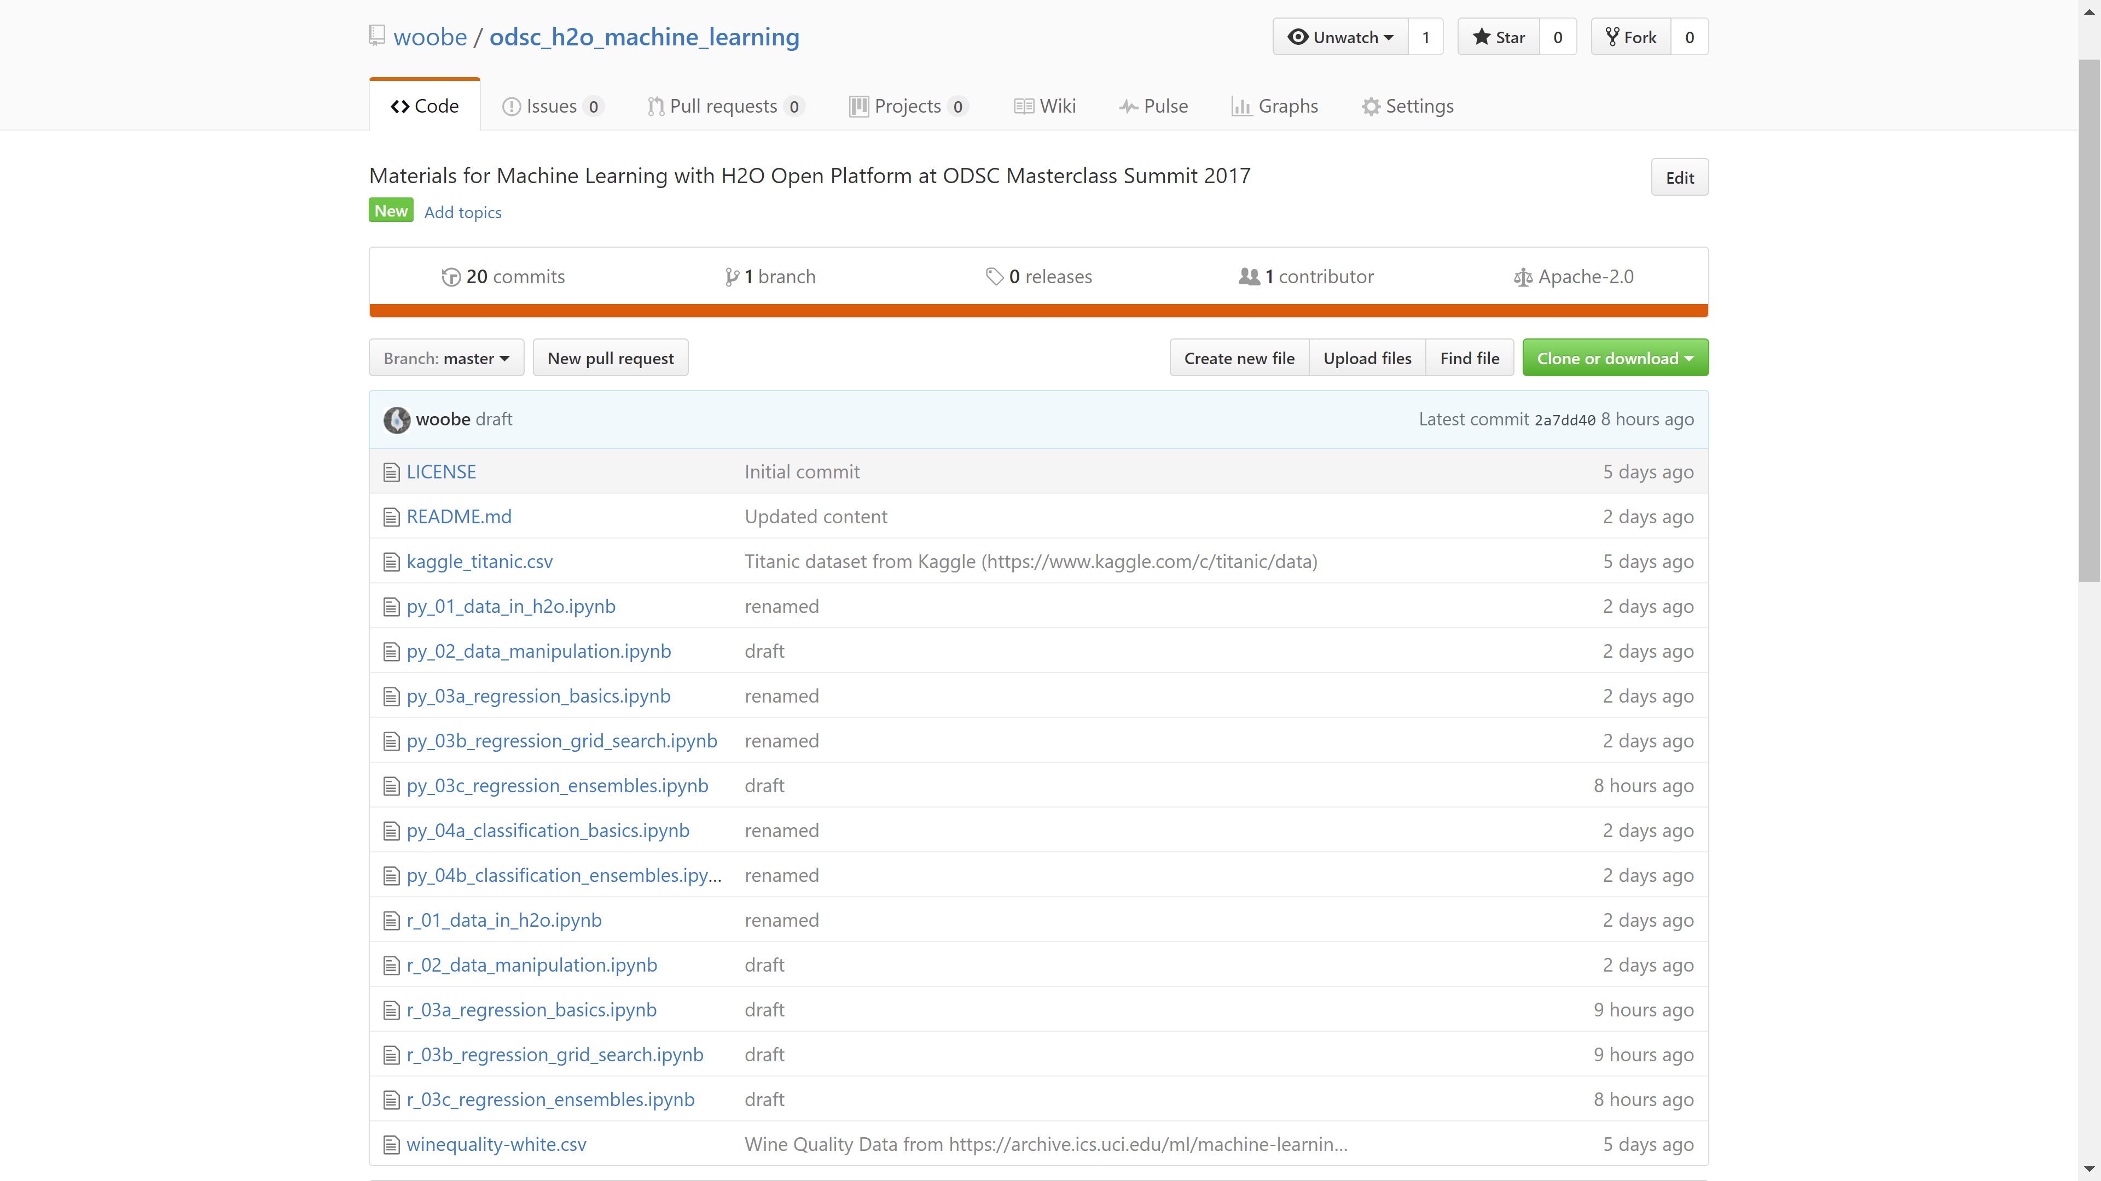

Slide 6
About H₂O.ai

Slide 7
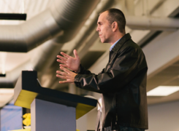
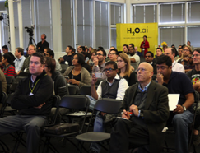
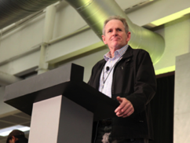
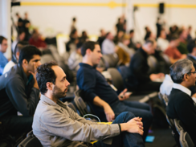
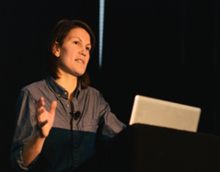
Company Overview
Founded | 2011 Venture-backed, debuted in 2012
Products | H₂O Open Source In-Memory AI Prediction Engine Sparkling Water Steam
Mission | Operationalize Data Science, and provide a platform for users to build beautiful data products
Team | 70 employees Distributed Systems Engineers doing Machine Learning World-class visualization designers
Headquarters | Mountain View, CA

Slide 8
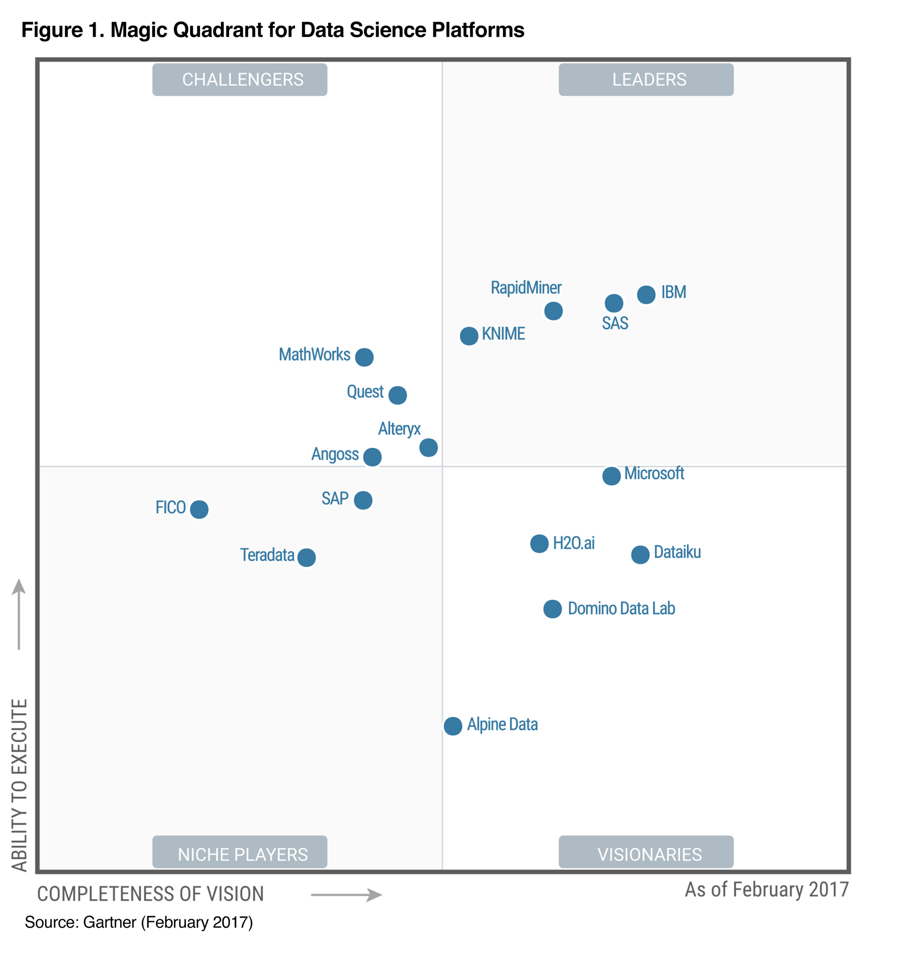
Joe the Outlier
Joe (2015)
Joe (Water Engineer)
http://www.h2o.ai/gartner-magic-quadrant/

Slide 9
Algorithms Overview
Supervised Learning
Unsupervised Learning
Statistical Analysis
Generalized Linear Models: Binomial, Gaussian, Gamma, Poisson and Tweedie
Naïve Bayes
K-means: Partitions observations into k clusters/groups of the same spatial size. Automatically detect optimal k
Clustering
Distributed Random Forest: Classification or regression models
Gradient Boosting Machine: Produces an ensemble of decision trees with increasing refined approximations
Principal Component Analysis: Linearly transforms correlated variables to independent components
Generalized Low Rank Models: extend the idea of PCA to handle arbitrary data consisting of numerical, Boolean, categorical, and missing data
Dimensionality Reduction
Ensembles
Deep Neural Networks
Deep learning: Create multi-layer feed forward neural networks starting with an input layer followed by multiple layers of nonlinear transformations
Anomaly Detection
Autoencoders: Find outliers using a nonlinear dimensionality reduction using deep learning

Slide 10



High Level Architecture
HDFS
H₂O Compute Engine
S3
Load Data
Exploratory &
Descriptive
Analysis
Supervised &
Unsupervised
Modeling
Predict
Distributed
In-Memory
NFS
Feature Engineering &
Selection
Model Evaluation &
Selection
Data & Model Storage
Loss-less
Compression
Local
Data Prep Export:
Plain Old Java Object
Model Export:
Plain Old Java Object
SQL
Production Scoring Environment
Your
Imagination
Notes:
Works on Hadoop & Spark
Key capabilities
Distributed in-memory algorithms
Columnar compression
Feature Engineering
EDA
Data Munging
Supervised Learning Algorithms
Unsupervised Learning Algorithms
Model deployment via POJO

Slide 11
High Level Architecture
Flow (Web), R, Python API
Java for computation
HDFS
H₂O Compute Engine
S3
Load Data
Exploratory &
Descriptive
Analysis
Supervised &
Unsupervised
Modeling
Predict
Distributed
In-Memory
NFS
Feature Engineering &
Selection
Model Evaluation &
Selection
Data & Model Storage
Loss-less
Compression
Local
Data Prep Export:
Plain Old Java Object
Model Export:
Plain Old Java Object
SQL
Production Scoring Environment
Your
Imagination
Notes:
Works on Hadoop & Spark
Key capabilities
Distributed in-memory algorithms
Columnar compression
Feature Engineering
EDA
Data Munging
Supervised Learning Algorithms
Unsupervised Learning Algorithms
Model deployment via POJO

Slide 12
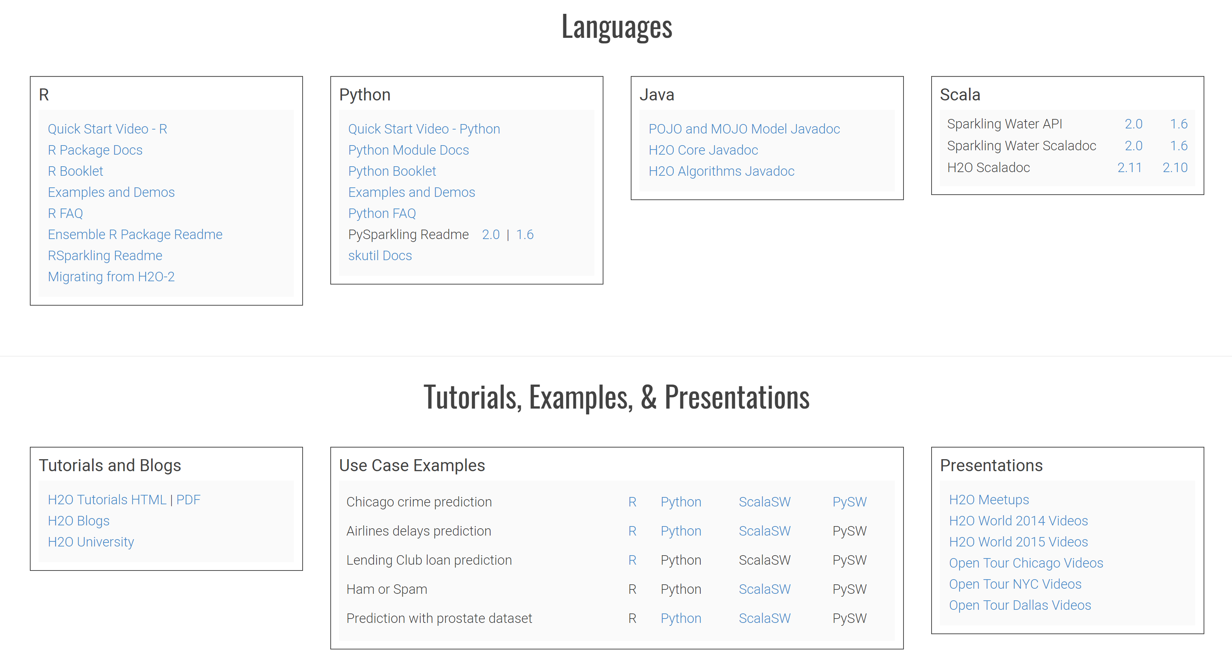
docs.h2o.ai

Slide 13
Start and Connect to a Local H2O Cluster
…_01_data_in_h2o.ipynb

Slide 14
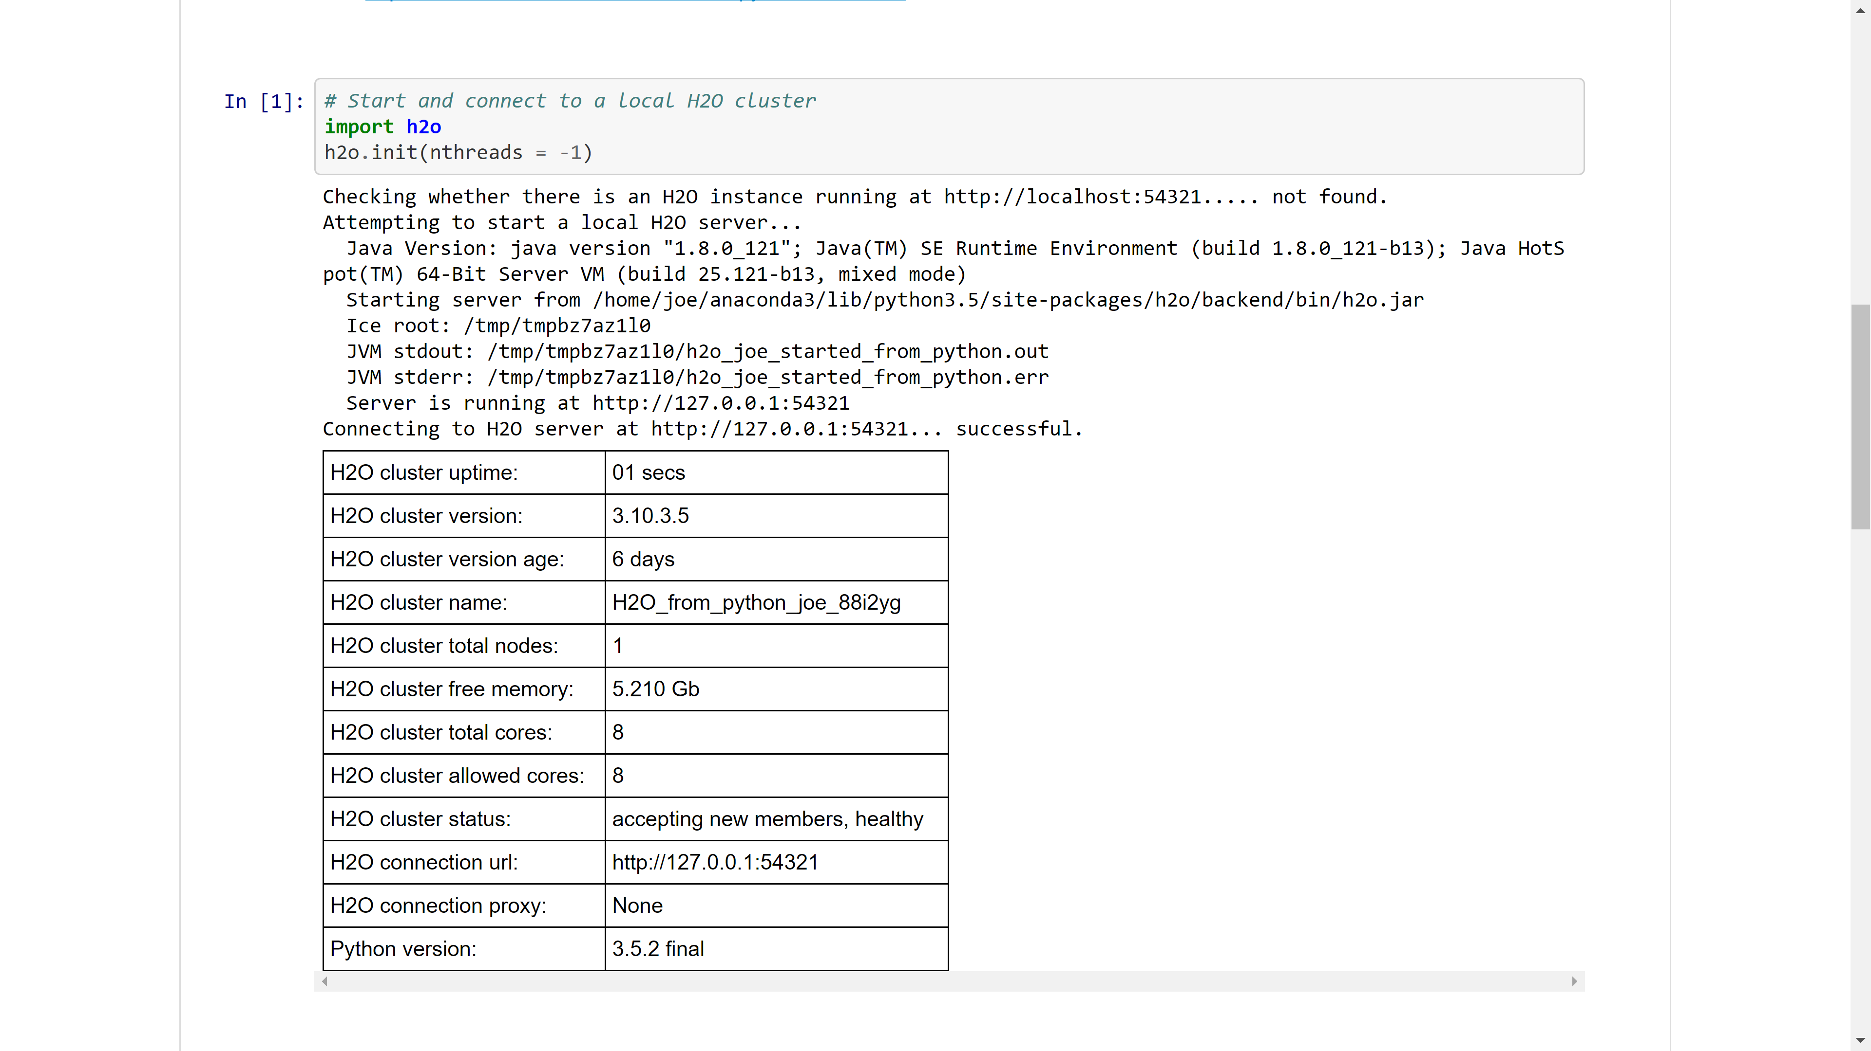

Slide 15
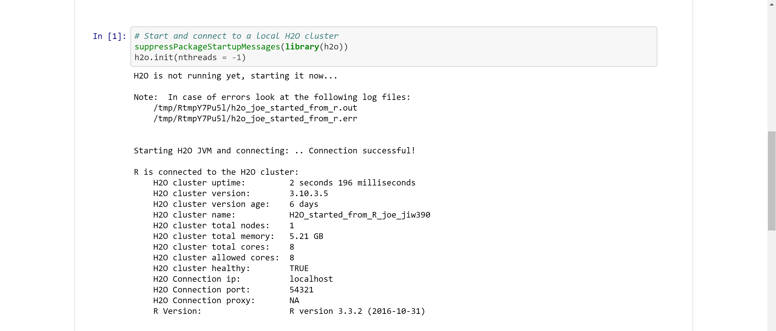

Slide 16
Importing Data into H₂O
…_01_data_in_h2o.ipynb

Slide 17
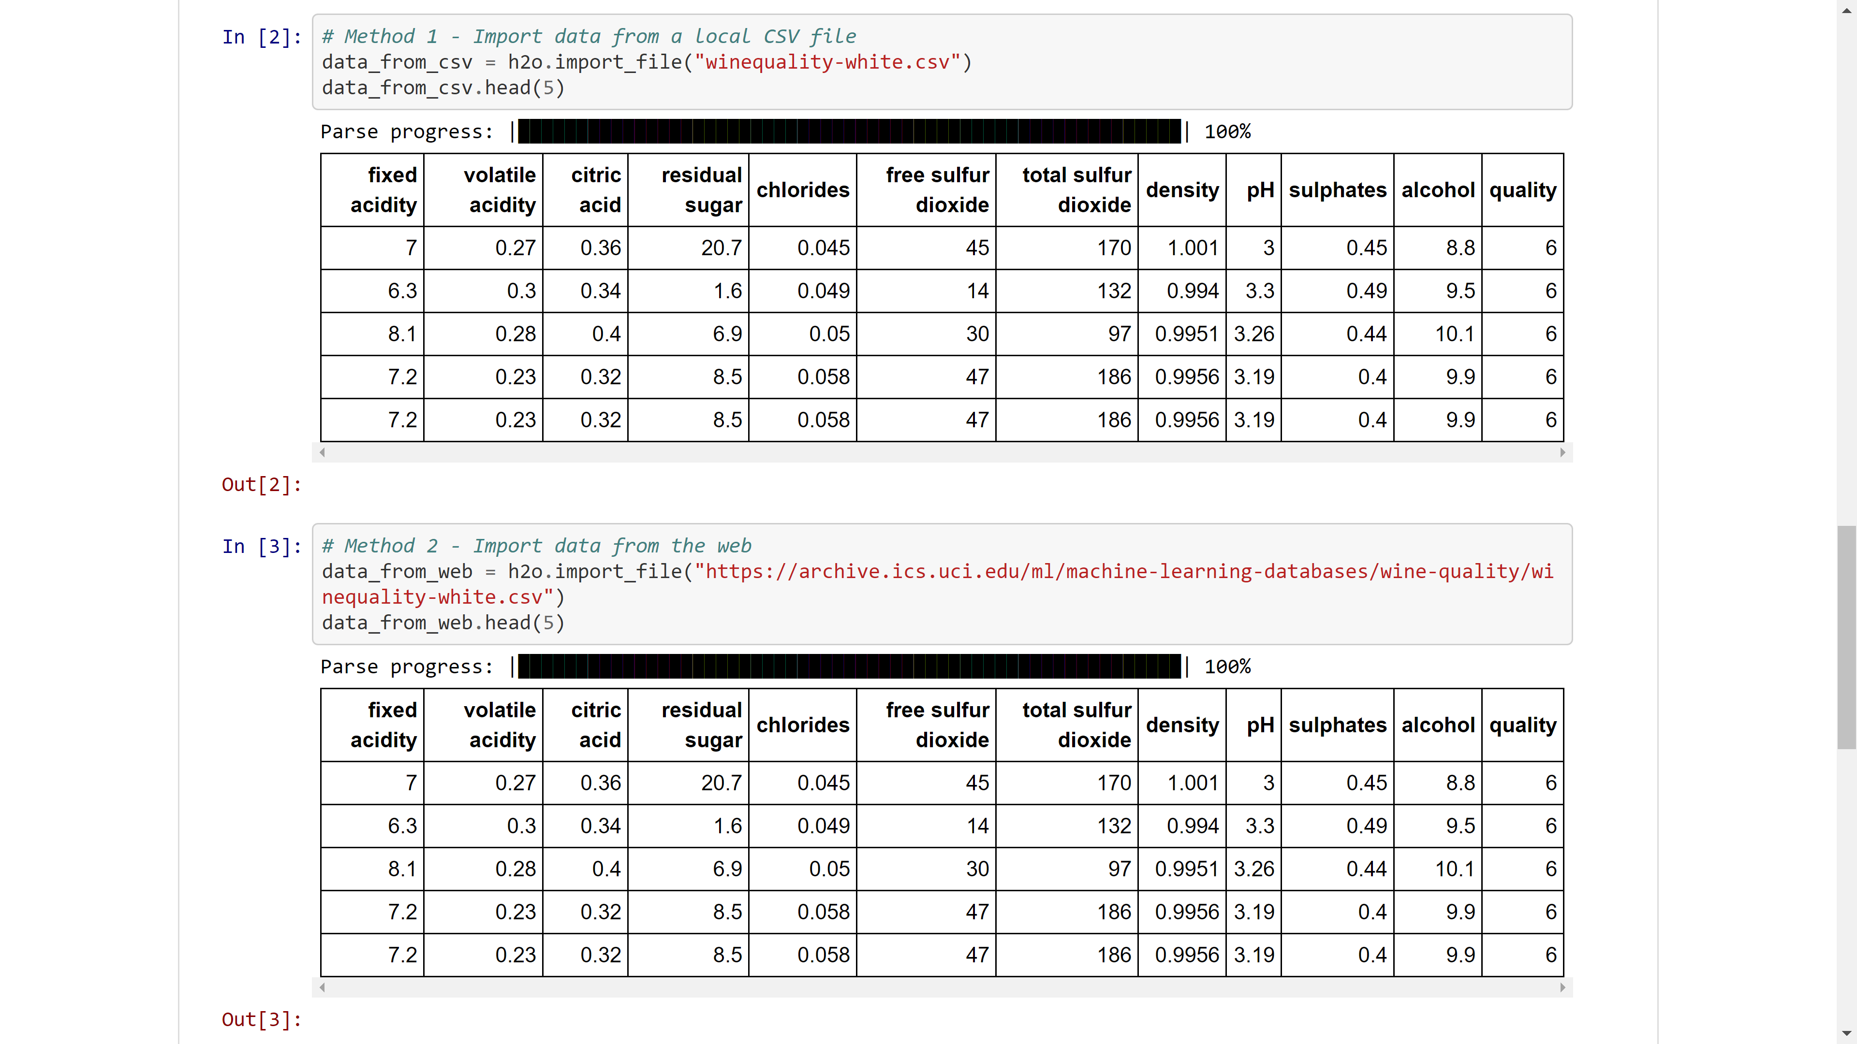

Slide 18
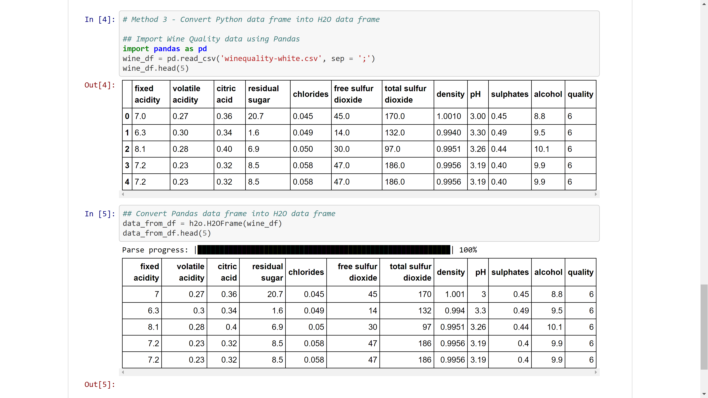

Slide 19
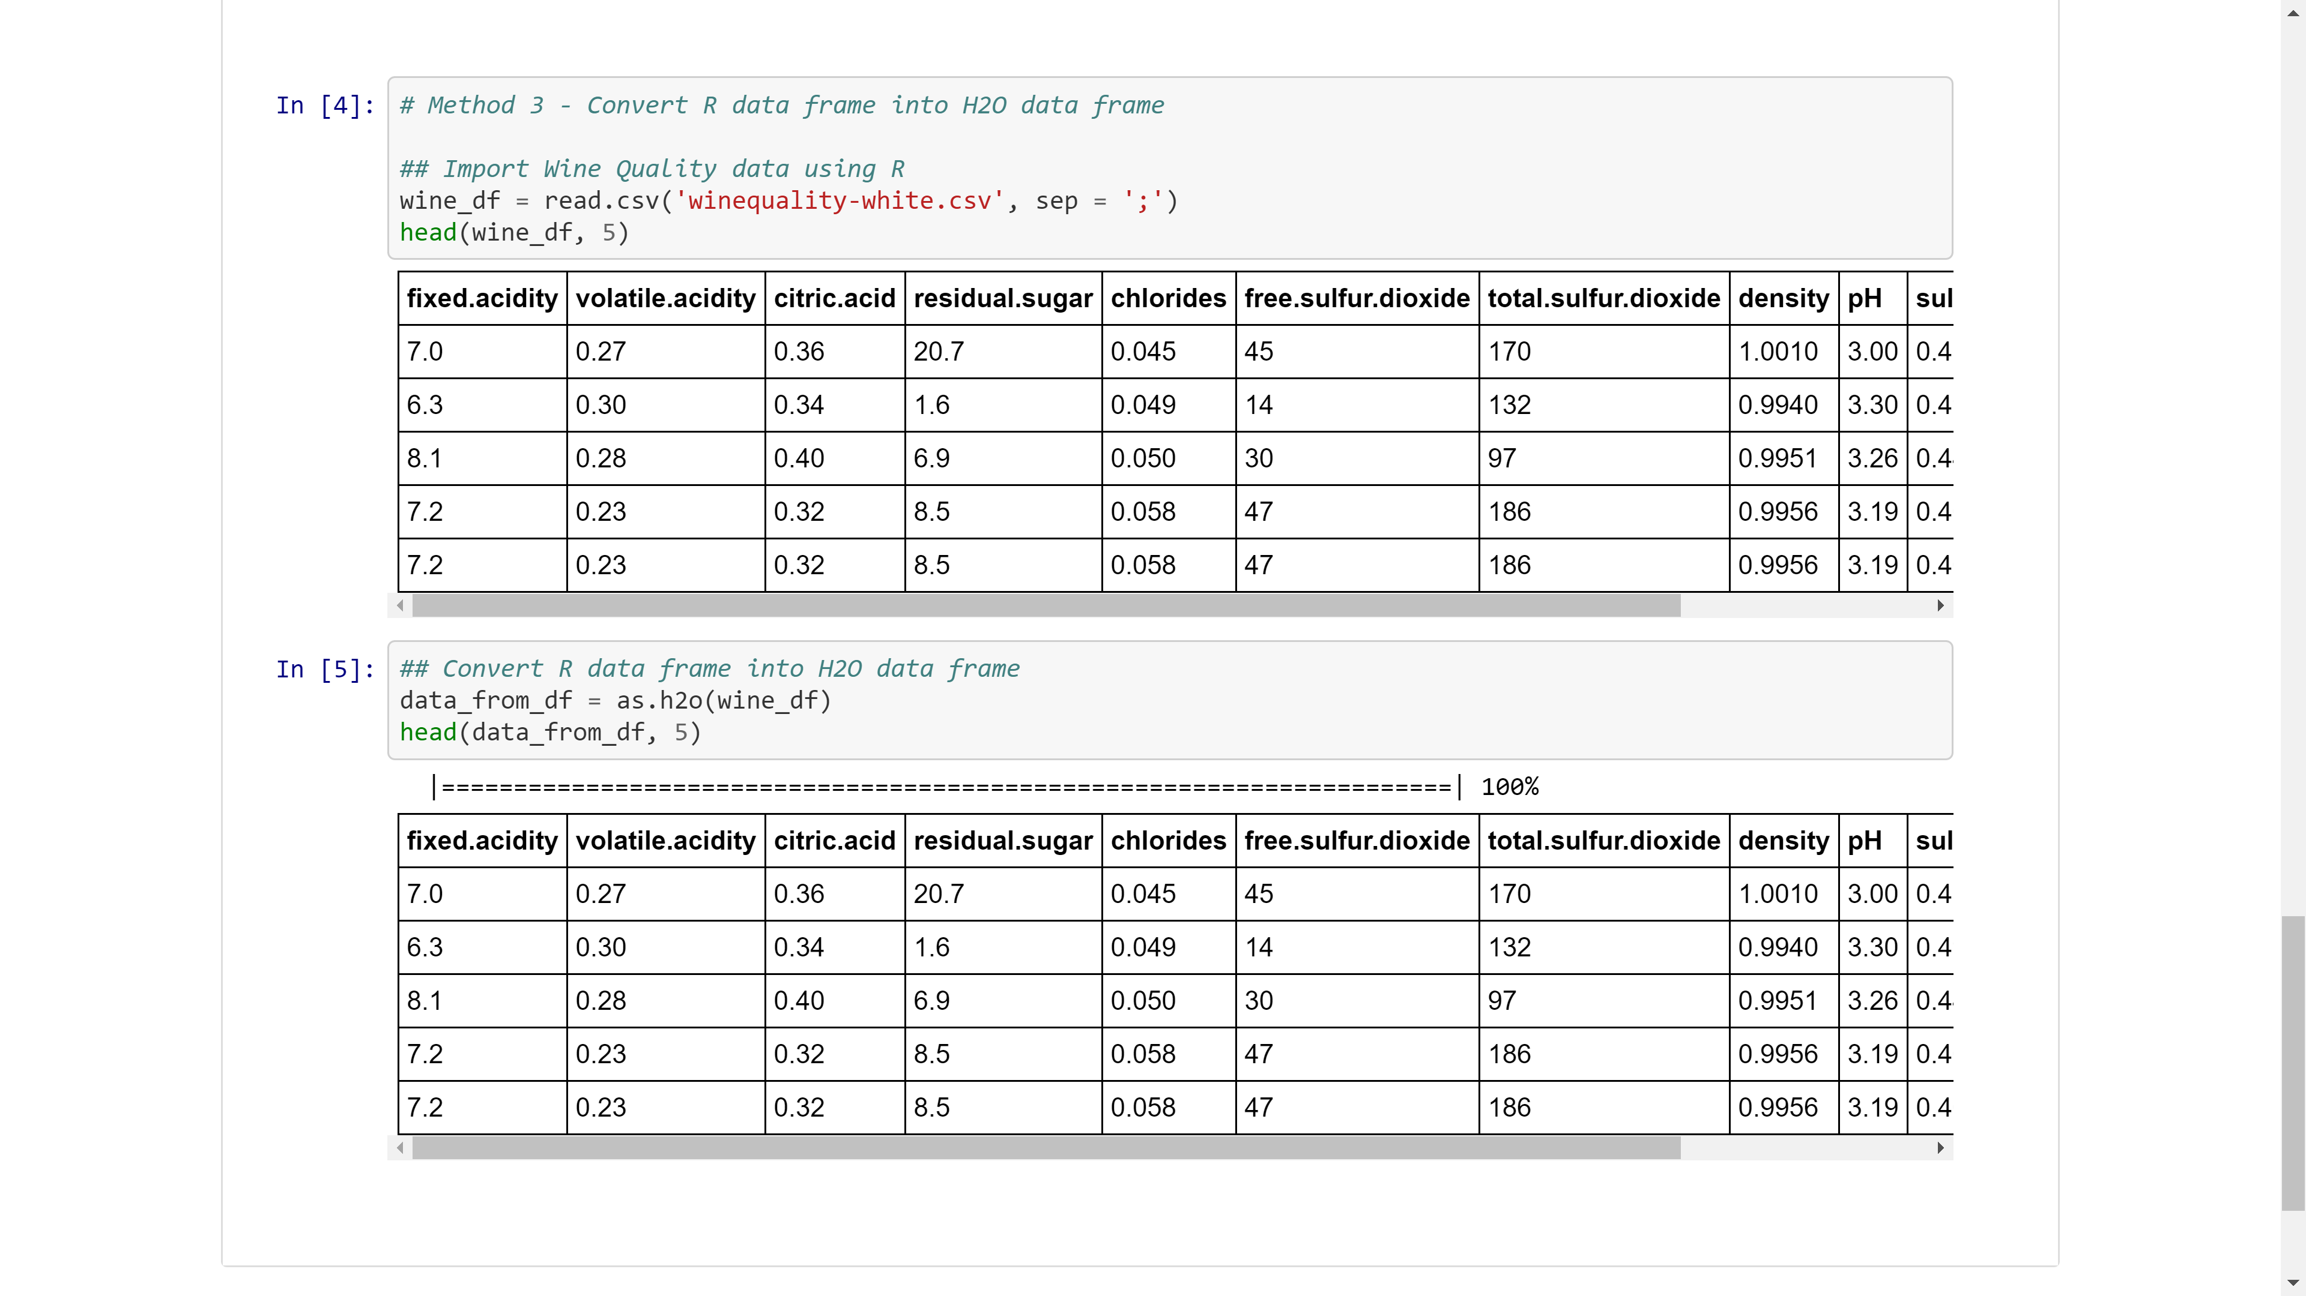

Slide 20
Basic Data Transformation & Exploration
…_02_data_manipulation.ipynb
(see notebooks)

Slide 21
Regression & Classification Models (Basics)
…_03a_regression_basics.ipynb
…_04a_classification_basics.ipynb

Slide 22
Algorithms Overview
Supervised Learning
Unsupervised Learning
Statistical Analysis
Generalized Linear Models: Binomial, Gaussian, Gamma, Poisson and Tweedie
Naïve Bayes
K-means: Partitions observations into k clusters/groups of the same spatial size. Automatically detect optimal k
Clustering
Distributed Random Forest: Classification or regression models
Gradient Boosting Machine: Produces an ensemble of decision trees with increasing refined approximations
Principal Component Analysis: Linearly transforms correlated variables to independent components
Generalized Low Rank Models: extend the idea of PCA to handle arbitrary data consisting of numerical, Boolean, categorical, and missing data
Dimensionality Reduction
Ensembles
Deep Neural Networks
Deep learning: Create multi-layer feed forward neural networks starting with an input layer followed by multiple layers of nonlinear transformations
Anomaly Detection
Autoencoders: Find outliers using a nonlinear dimensionality reduction using deep learning

Slide 23
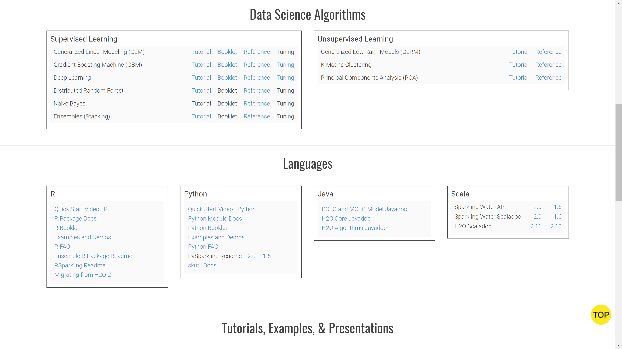
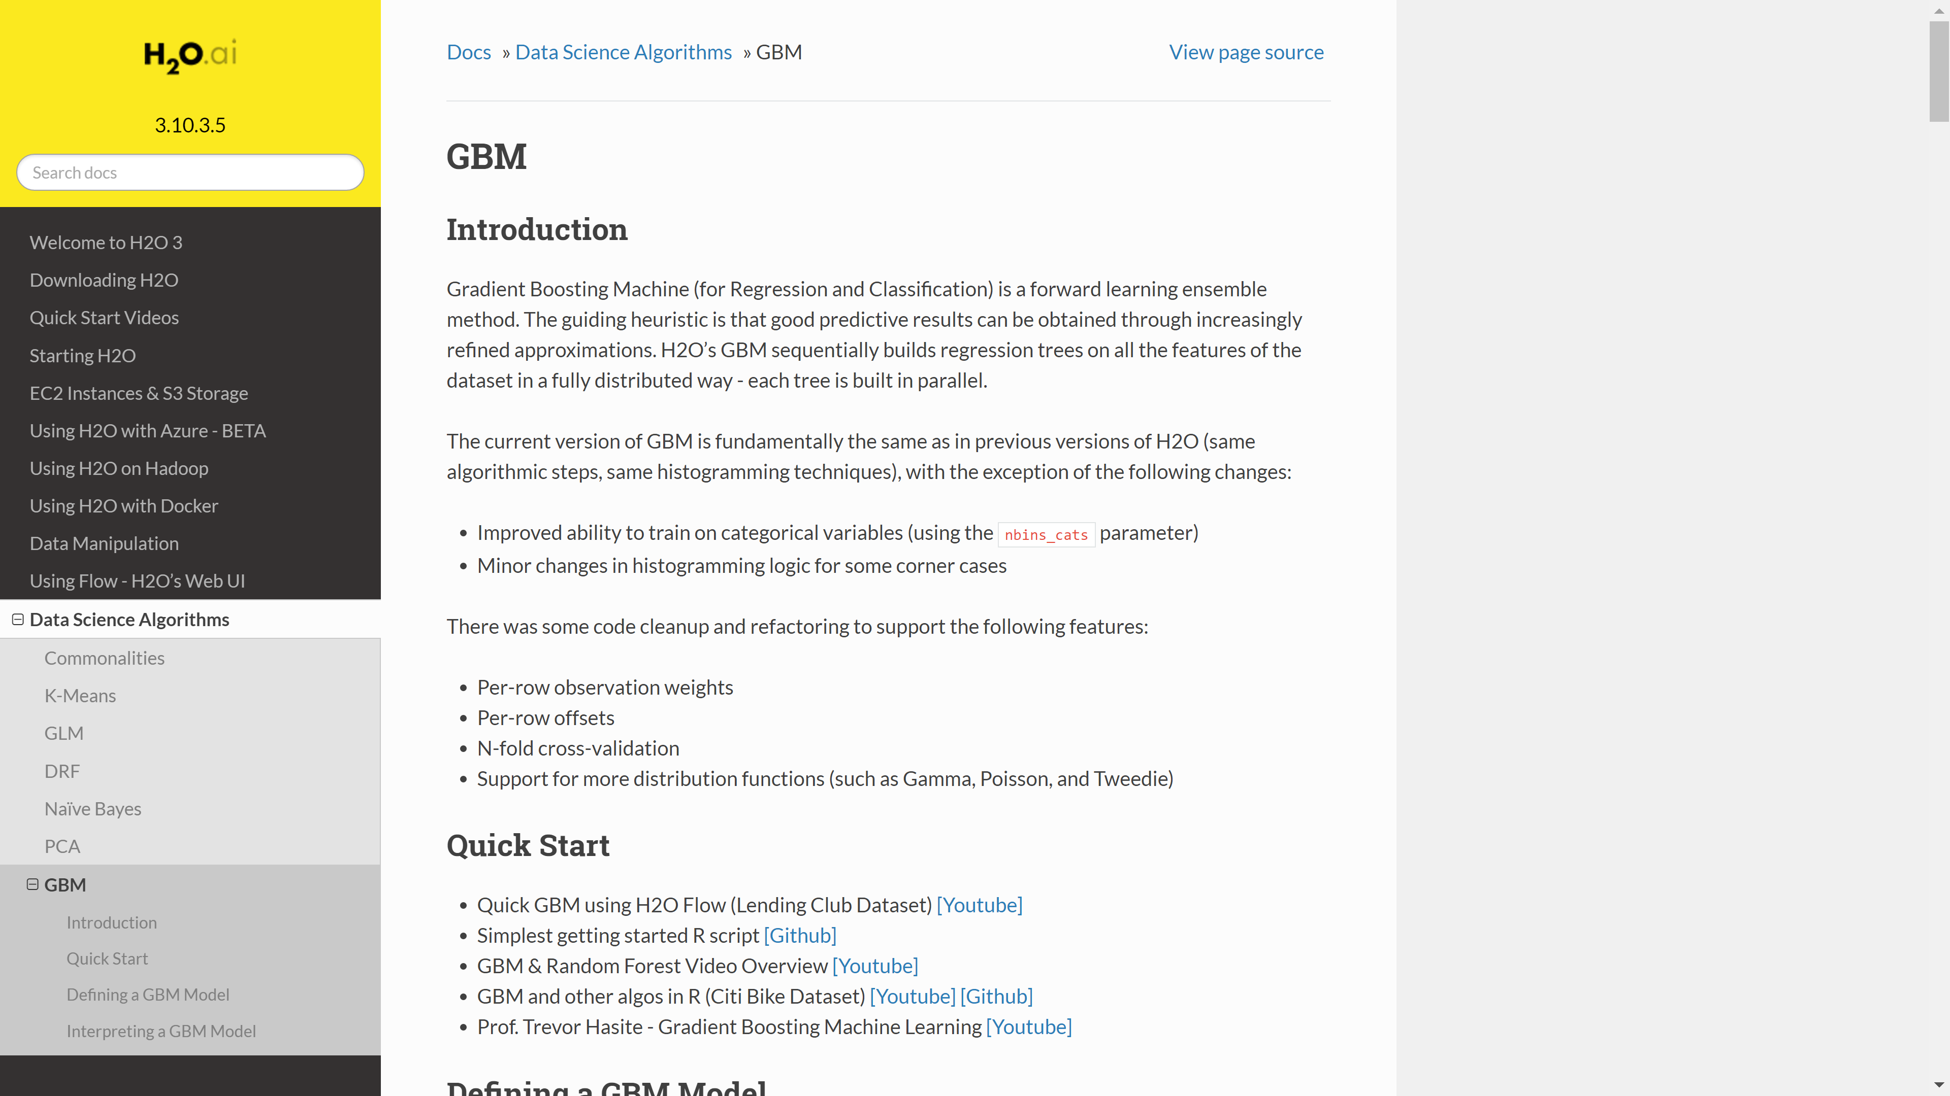
docs.h2o.ai

Slide 24
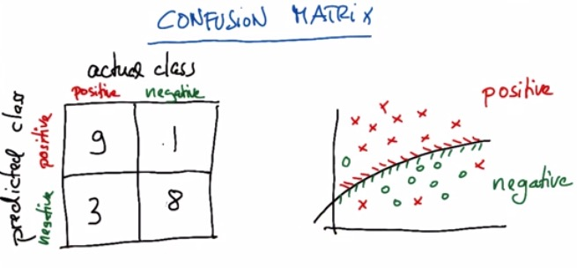
Confusion Matrix

Slide 25
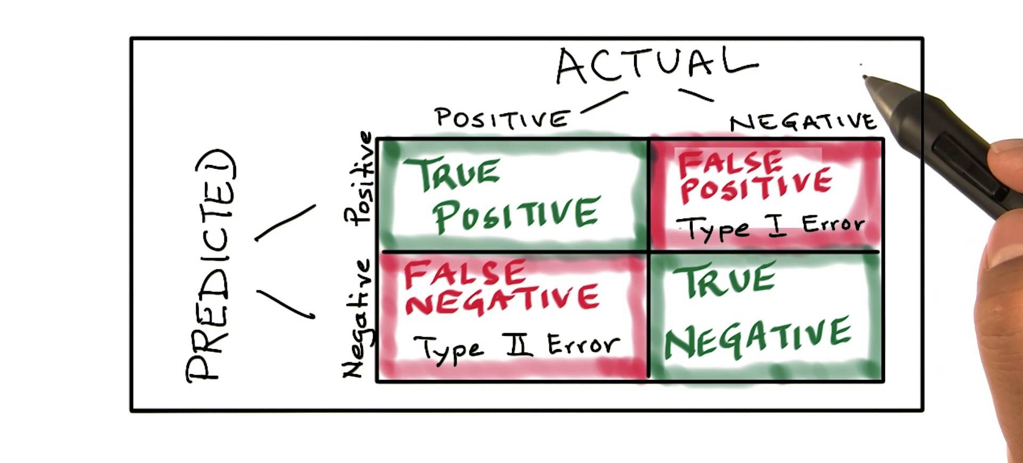
Confusion Matrix

Slide 26
Regression Models (Grid Search)
…_03b_regression_grid_search.ipynb

Slide 27
Improving Model Performance (Step-by-Step)
Model Settings | MSE (CV) | MSE (Test)
GBM with default settings | N/A | 0.4551
GBM with manual settings | N/A | 0.4433
Manual settings + cross-validation | 0.4502 | 0.4433
Manual + CV + early stopping | 0.4429 | 0.4287
CV + early stopping + full grid search | 0.4378 | 0.4196
CV + early stopping + random grid search | 0.4227 | 0.4047
Stacking best two from random grid search | N/A | 0.3997

Slide 28
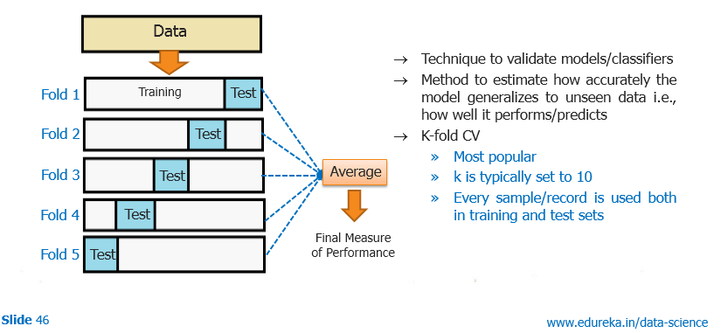
Cross-Validation

Slide 29
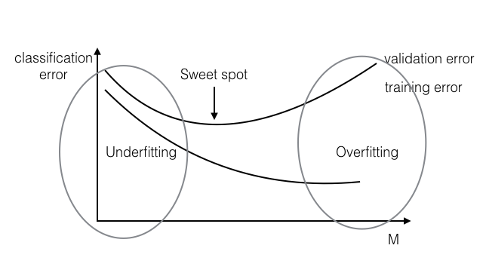
Early Stopping

Slide 30
Regression Models (Ensembles)
…_03c_regression_ensembles.ipynb

Slide 31
Improving Model Performance (Step-by-Step)
Model Settings | MSE (CV) | MSE (Test)
GBM with default settings | N/A | 0.4551
GBM with manual settings | N/A | 0.4433
Manual settings + cross-validation | 0.4502 | 0.4433
Manual + CV + early stopping | 0.4429 | 0.4287
CV + early stopping + full grid search | 0.4378 | 0.4196
CV + early stopping + random grid search | 0.4227 | 0.4047
Stacking best two from random grid search | N/A | 0.3997

Slide 32
Recap

Slide 33
Learning Objectives
Start and connect to a local H₂O cluster from R/Python.
Import data from R/Python data frames, local files or web.
Perform basic data transformation and exploration.
Train classification and regression models using H₂O machine learning algorithms.
Evaluate models and make predictions.
Improve performance by tuning and stacking.

Slide 34
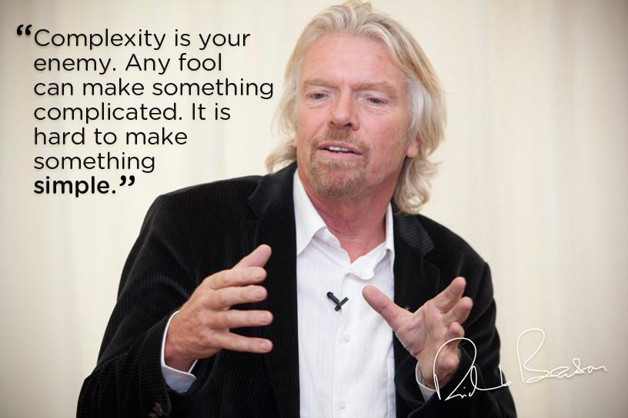
Thanks!
Slides
bit.ly/h2o_meetups
Contact
joe@h2o.ai
@matlabulous
github.com/woobe
Making Machine Learning Accessible to Everyone
Photo credit: Virgin Media

